Slide 1
Field survey
Relevance and limitations

Slide 2
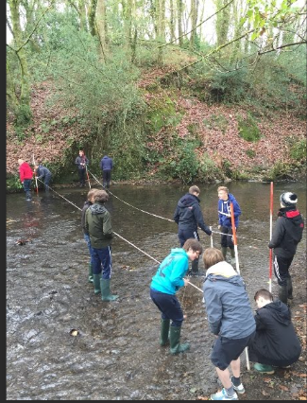

Slide 3
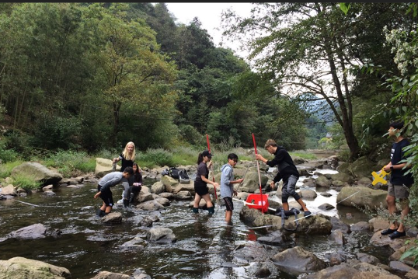

Slide 4
Relevance of field survey
To understand man environment relationship
To get latest information
To get concrete knowledge of some required facts
To get wholesome knowledge of the area of research
To get in touch with natural environment
Skill development
Learn mutual cooperation
To verify facts published

Slide 5
Limitations of field work
Time consuming process
Language problem
Very expensive
Adversity of climate and physiography
Non availability of equipment
Non cooperation of people
Non cooperation of respondents
Tiring exercise

